Slide 1
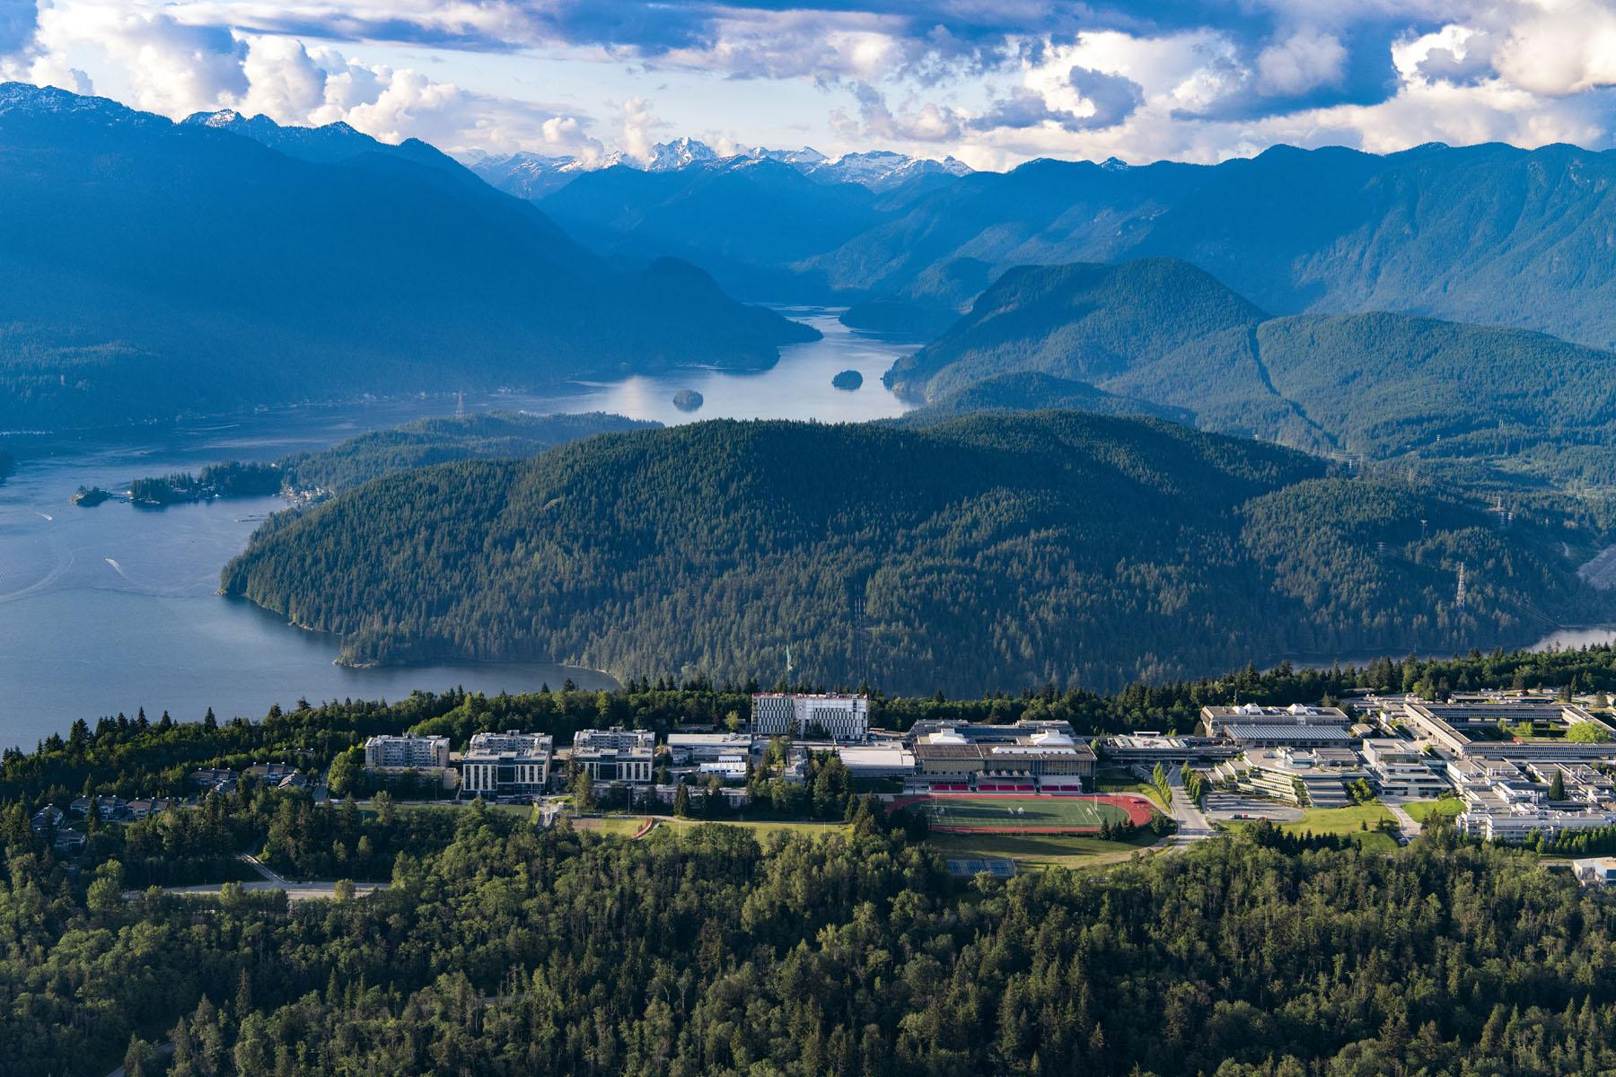

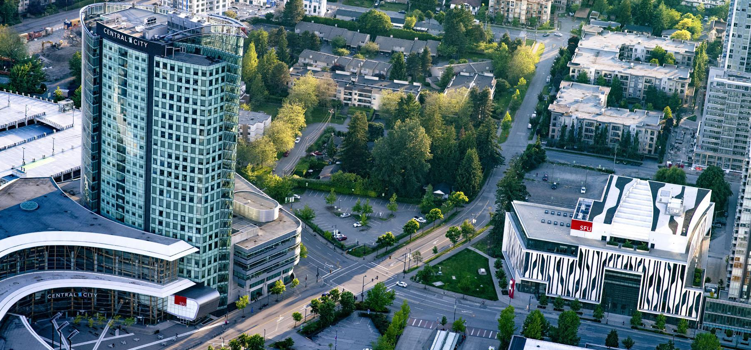
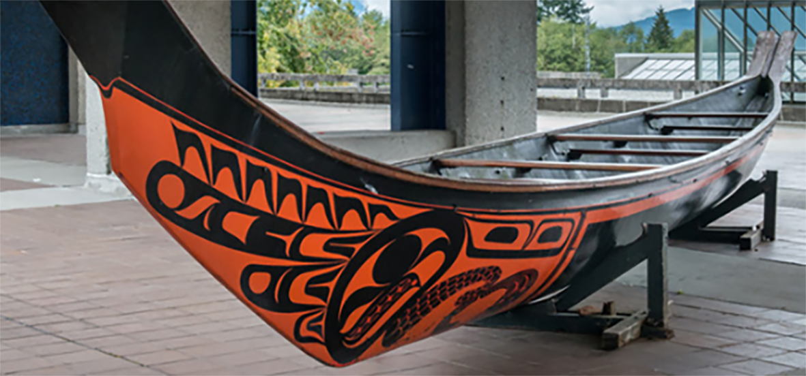

Writing a Tri-Agency Research Proposal
El Chenier
Professor and Associate Dean, Faculty of Graduate Studies

Slide 2
Accessibility
Accommodations and accessibility
If you need help completing online application forms because of a disability, contact [Centre for Accessible Learning and/or me, the Associate Dean of Graduate Studies, Scholarship ad_schol@sfu.ca and/or Stephanie Santoso, Grad Award Manager mgr_awards@sfu.ca and/or the Graduate Student Support and Advocacy team gsadvsup@sfu.ca) as early as possible in the application process to investigate available supports. If your institution cannot provide help, or needs SSHRC to collaborate on a solution, refer to the Accessibility in programs and services webpage for information on requesting assistance or contact accessibility-accessibilite@sshrc-crsh.gc.ca directly. You can also contact SSHRC if you have questions or are seeking specific adaptation arrangements. You do not need to share your medical or sensitive personal information and, to protect your privacy, should avoid doing so.
Frequently requested accommodations include, but are not limited to:
one-on-one phone or video appointment to clarify funding program information or the application process, or to receive technical support;
alternative formats of online materials to enable access using assistive technology; and
submission of the application (in full or part) through alternate means or format (e.g., hard copy, voice recording, or data entry by SSHRC staff on the applicant’s behalf).
If submitting a request to accessibility-accessibilite@sshrc-crsh.gc.ca for an adaptive measure, provide:
your name and institutional affiliation, or the name of the institution submitting the application, as applicable;
the name of the funding opportunity and its competition deadline;
the barrier you are encountering; and
the adaptive measure you are seeking, if known.
https://sshrc-crsh.canada.ca/en/funding/opportunities/canada-graduate-research-scholarships/doctoral-program/2025/competition/instructions/applicant.aspx

Slide 3
Research Proposals: Some General Pointers
You are not starting from scratch; you are (probably) developing/building on the research proposal you submitted when you applied to GS
The process of writing a proposal should help you sharpen, develop, and clarify your ideas, thinking, methodology, etc. It is not a form you just fill out; it is something you craft.
Good proposals take time – plan for three to four drafts
  Ask your supervisor and peers to read and comment on your draft(s); factor in the time it will take for them to get back to you
Follow the application instructions carefully

Slide 4
CGS Master’s Evaluation Criteria
Criteria | Value/Weight
Academic Excellence | 50%
Research Potential | 30%
Personal/Interpersonal Skills and Characteristics | 20%

Slide 5
CGS-M Indicators: Research Potential (30%)
As demonstrated by your research history, your interest in discovery, the proposed research, its potential contribution to the advancement of knowledge in the field and any anticipated outcomes
Indicators of research potential:
quality and originality of contributions to research and development
relevance of work experience and academic training to field of proposed research
significance, feasibility and merit of proposed research
judgment and ability to think critically
ability to apply skills and knowledge
initiative and autonomy
research experience and achievements relative to expectations of someone with your academic experience

Slide 6
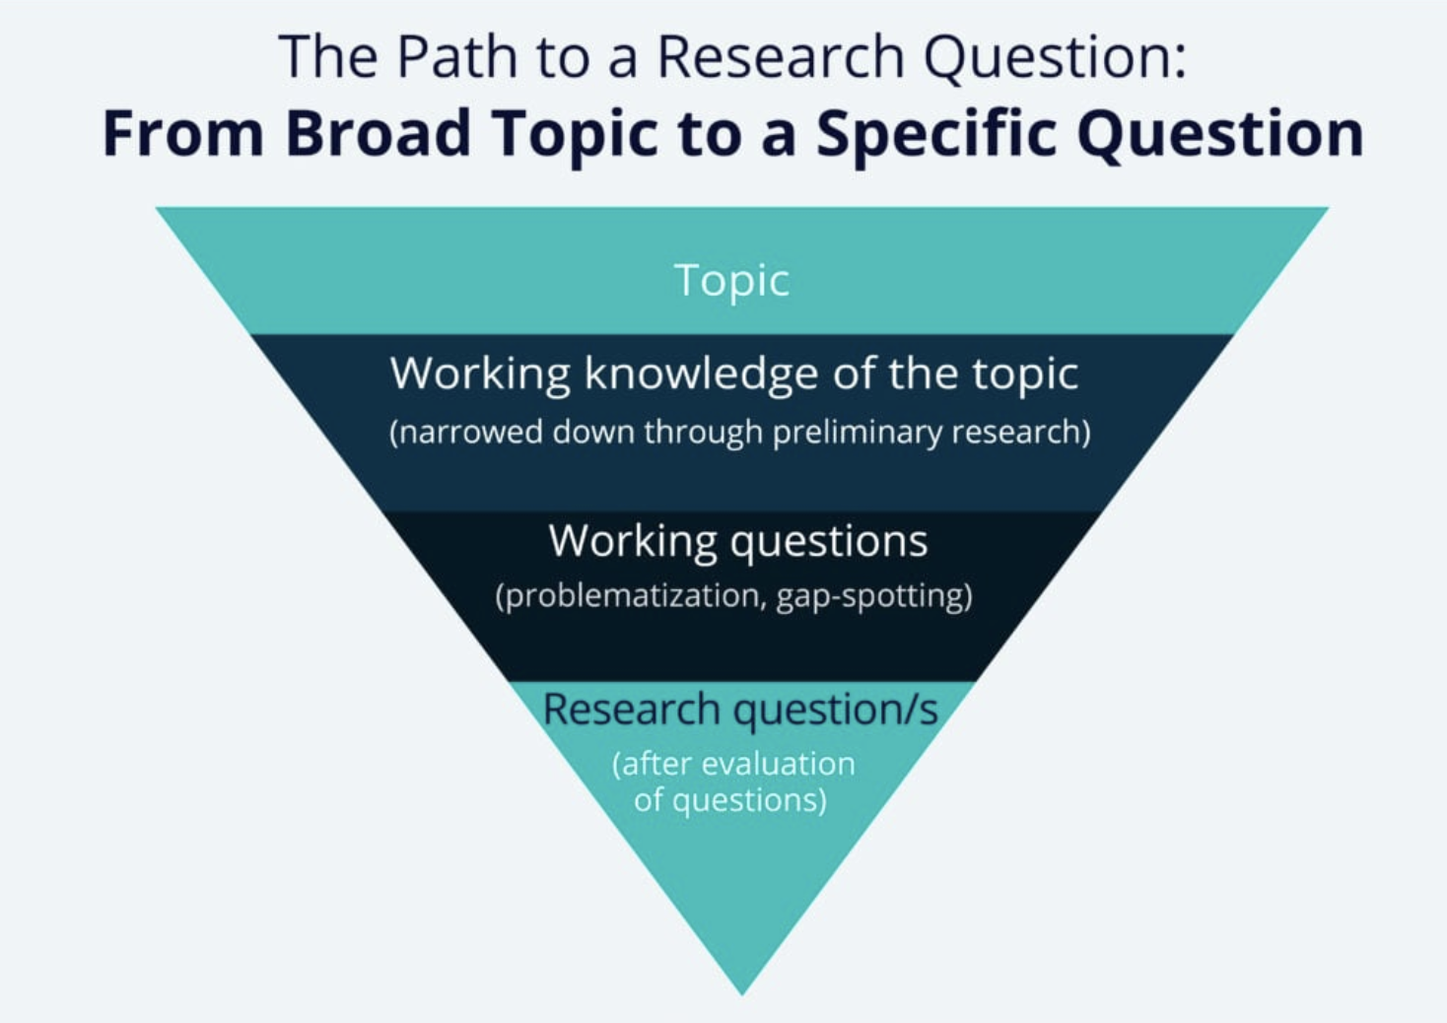
Notes:
Write your topic in the chat.

Slide 7
What is your research question?
Take a moment to post in the chat your research question in a single sentence. Feel free to refer to your grad school application.

Slide 8
Outline of proposed research (attachment) The single attachment consists of two separate sections: Outline of proposed research and Bibliography and citations. Each of these sections must be only one page.
Outline of proposed research (one page maximum)
Provide a detailed description of your proposed research project for the period during which you will hold the award.
Be as specific as possible.
Provide background information to position your proposed research within the context of current knowledge in the field.
State:
  the objectives and hypothesis and outline the experimental or theoretical approach to be taken (citing literature pertinent to the proposal) and
  the methods and procedures to be used.
State the significance of the proposed research to a field or fields in the health sciences, natural sciences and/or engineering or social sciences and/or humanities, as appropriate.
Notes:
Click on the image of the text to go to the document.
Additional subheadings used include:
Methodology
Hypothesis
Advancement of Knowledge
My Qualifications

Slide 9
​
If the output of your degree program is an artistic creation rather than a thesis, clearly indicate the research component of your proposed work. Outline the objectives of your research, the context, methodology and contribution to the advancement of knowledge.
If your degree program does not involve a thesis, a major research paper/essay or a major research project, clearly outline the research component of the degree.
If you have not yet decided on a specific project, you must still provide a detailed description of a proposed research project. You may change your research direction or activities during the course of the award. Certain restrictions may apply. Refer to the Tri-agency research training award holder’s guide.​
In addition:​
You are expected to write your outline of proposed research independently. Ideas and text belonging to others must be properly referenced.​
Include all relevant information in the outline. Do not refer reviewers to URLs or other publications for supplemental information.​
In the outline of proposed research, provide the requested information according to the guidelines and format standards outlined in the presentation standards.​
Bibliography and citations (one page maximum)​
Provide a bibliography that includes citations for all works referenced in the research proposal. These citations should be in a format used by the primary discipline of the proposed research.
​
Notes:
Click on the image of the text to go to the document.
Additional subheadings used include:
Methodology
Hypothesis
Advancement of Knowledge
My Qualifications

Slide 10
F Feasible
A good research question is feasible, which means that the question is well within the researcher’s ability to investigate. Researchers should be realistic about the scale of their research as well as their ability to collect data and complete the research with their skills and the resources available to them. It’s also wise to have a contingency plan in place in case problems arise.
I Interesting
The ideal research question is interesting not only to the researcher but also to their peers and community. This interest boosts the researcher’s motivation to see the question answered.
N Novel
Your research question should be developed to bring new insights to the field of study you are investigating. The question may confirm or extend previous findings on the topic you are researching, for instance.
E Ethical
This is one of the more important considerations of making a research question. Your research question and your subsequent study must be something that review boards and the appropriate authorities will approve.
R Relevant
Aside from being interesting and novel, the research question should be relevant to the scientific community and people involved in your area of study. If possible, your research question should also be relevant to the public’s interest.
-Hulley et al. (2007)

Slide 11
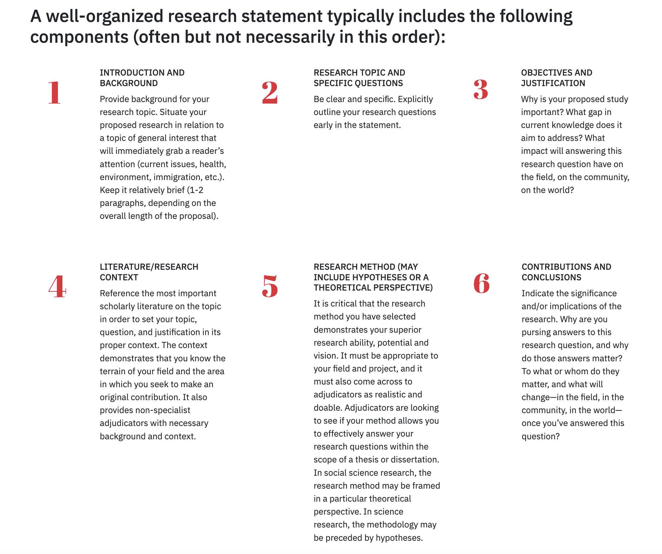
From York University:
Notes:
https://www.yorku.ca/gradstudies/students/current-students/awards-and-scholarships/a-guide-for-developing-successful-grant-proposals/

Slide 12
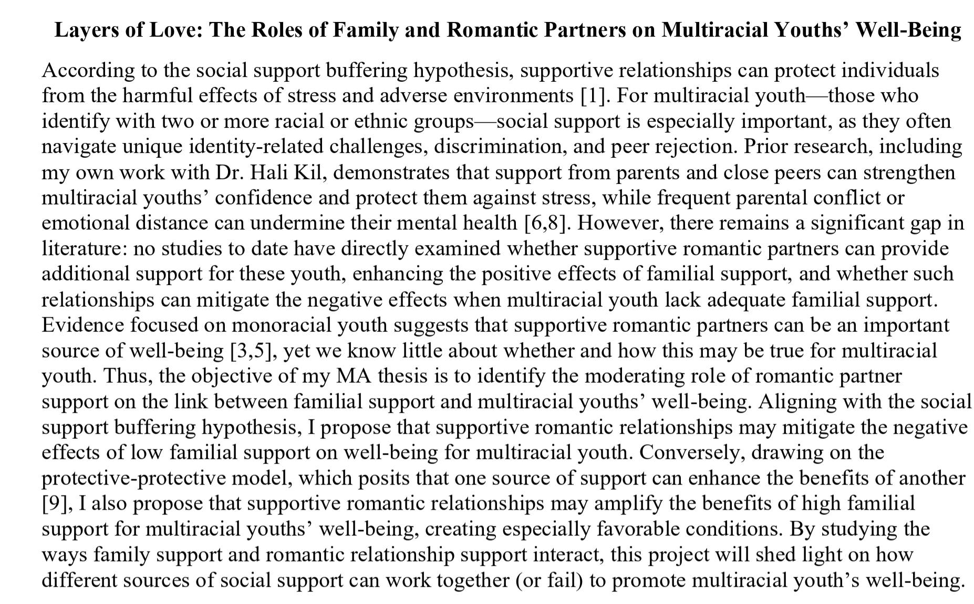











Catchy title
Theories/models
Clear and precise definition
Detailed and precise explanation for why
social support is especially important
Previous training and
my own expertise
Common phrases
Significance, impact, out-
come, results, contribution

Slide 13
Know your audience
Adjudicators are not necessarily in your discipline therefore:
avoid jargon, specialized language, explain concepts and methods so that they can be understood by a non-specialist
the scholarship-writing genre is unique; this is not an essay or thesis.

Slide 14
Common Errors
  Wrote too much under the background section; should not be more than 1/3 of the page.
  Methodology is weak – not enough information on how the research will be carried and whether it’s feasible within the time frame of their degree program.
  Too much jargon or too technical – the proposal needs to be written in a lay person's language.

Slide 15
Additional Resources
  SFU FGS Document Library (examples of successful proposals)
  How to Write a Research Proposal (University of Guelph)
  How to Write a Research Question
  SSHRC Proposal Writing Tips
  SFU Library Writing Services for Graduate Students

Slide 16

Final Words of Advice
“
Writing is the art of applying the ass to the seat.
— Dorothy Parker

