Slide 1
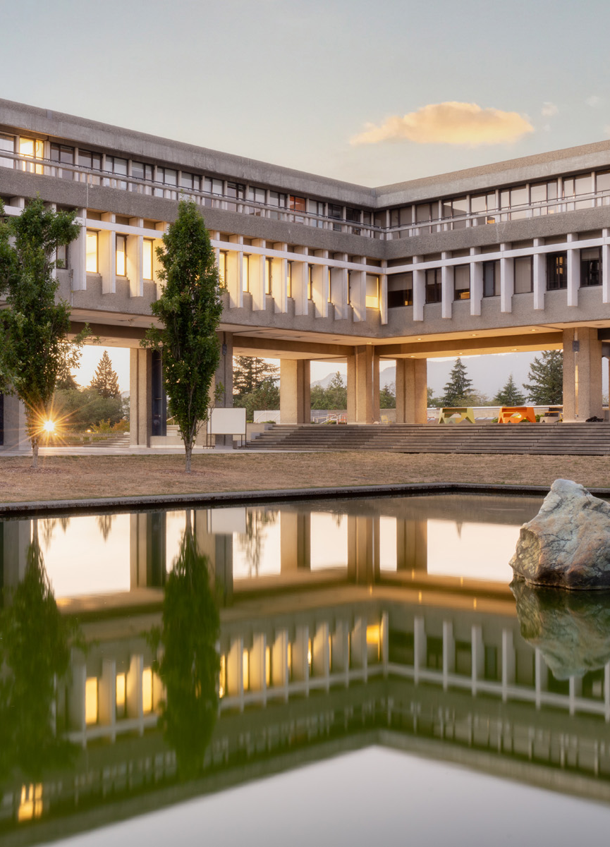
CIHR, NSERC + SSHRC (Tri-agencies)
2025 Master’s + PhD Funding

Slide 2
AGENDA
AGENDA
Tri-agencies
  Selecting the right agency
Canada Graduate Research Scholarship Masters (CGRS-M)
  Eligibility points & selection criteria
CIHR, NSERC & SSHRC Doctoral Scholarships (CGRS-D)
  Eligibility points, timeline, selection criteria
Graduate Studies Tips
  Referees, transcripts, common mistakes, resources

Slide 3
Tri-agencies
Tri-agencies refers to these federal research funding agencies:
CIHR: Canadian Institutes of Health Research
NSERC: Natural Sciences and Engineering Research Council
SSHRC: Social Sciences and Humanities Research Council
Selecting the correct agency
The following webpage has general guidelines for the eligibility of subject matter + for health related research topics:
https://science.gc.ca/site/science/en/interagency-research-funding/policies-and-guidelines/selecting-appropriate-federal-granting-agency
Notes:
Pro Tip: if you have to justify why your research fits within a specific agency, use some of the wording from the science.gc.ca website

Slide 4
CGRS Masters: $27,000 for 1 year
Fall 2025 Competition is open | Deadline: December 1 (5:00 PM PST)
Harmonized program: eligibility, application process and deadline is the same for CIHR, NSERC or SSHRC
Application: apply on the Research Portal + create a Canadian Common CV
Initiative + Supplements: applicants who are eligible for Initiatives + Supplements may need to self identify and/or upload additional information when they apply.
Instructions
The CGRSM Program Resources page provides instructions for completing the application, attachments, CCV and referee assessment form. The instructions provide page limits, what to include in each section/attachment.
No changes can be made after an application has been submitted, either before or after the deadline.
SFU Resources
For SFU’s process and timeline: Graduate Studies CGRSM page
For samples of award winning applications: Sample Document Library
Notes:
If you are entering directly from a Bachelor’s program without having ever been enrolled in any graduate programs (direct-entry) – you may be eligible for the CGRS M before applying for the CGRS D. It would maximize your funding opportunities.

Slide 5
CGRS Masters: notes on main eligibility points
Eligibility basics and discussion (visit CGRSM eligibility for full list)
Must be Canadian citizen, permanent resident of Canada or Protected Person as of the application deadline date
be enrolled in, have applied for or will apply for full-time admission* to an eligible graduate program at the master’s or doctoral level at a Canadian institution with a CGRS M allocation
have completed, as of December 31 of the year of application:
  either between 0 and 12 months of full-time studies (or equivalent) in the program for which you are requesting funding
  between 4 and 12 months of full-time study (equivalent) in an eligible master’s program BUT going to use award for doctoral program….
have achieved a first-class average, as determined by the host institution, in each of the last two completed years of study (full-time equivalent)
December 1, 2025
Eligible programs have a significant research component.
SFU has allocations.
Sept 2025 - Dec 31, 2025 =
4 months
CGPA 3.67 = pass
If not, we calculate your last 60 credits

Slide 6
Selection Criteria – CGRS Master’s
Academic Excellence 50%
Academic record
Scholarships and awards held
Research Potential 30%
Quality and originality of contributions to research and development
Relevance of work experience and academic training to field of proposed research
Significance, feasibility and merit of proposed research
Personal Characteristics and Interpersonal Skills 20%
Work experience
Leadership experience
Project management, including organizing conferences and meetings
Visit the CGRS – Masters Program for full description of the selection criteria.

Slide 7
CIHR, NSERC and SSHRC Doctoral Scholarships
SFU Internal Deadline: October 1 at 4:30 PM (PST)
Harmonization: harmonized value and duration ($40,000/year for 3 years) but different systems
CGRSD: 1 competition – Canada Graduate Research Scholarship – Doctoral (CGRS D).
The following have been discontinued: NSERC PGS D, SSHRC Doctoral Fellowships, and Vanier CGSD.
CIHR CGRS - Doctoral
$40,000/year for 3 years
Eligibility + Instructions
Application on ResearchNET + CCV
NSERC CGRS - Doctoral
$40,000/year for 3 years
Eligibility + Instructions
Application on NSERCs Online system
SSHRC CGRS - Doctoral
$40,000/year for 3 years
Eligibility + Instructions
Online system + SSHRC CV

Slide 8
CIHR, NSERC & SSHRC Doctoral Timeline
MAY
2026
APRIL
2026
NOVEMBER
28
GS pays award
NOVEMBER
21
Agency decisions
are announced.
Early NOVEMBER
University submits applications to agency (SSHRC)
University submits applications to agency (CIHR and NSERC)
OCTOBER 1
4:30 PM (PST)
(SFU Internal Deadline)
University committee review
Direct applicant deadline: October 17
If you aren’t enrolled/haven’t been enrolled in a Canadian degree program in the past year, visit
where do I submit my application?
Student applies on
Tri-Agency portal
If the SFU internal deadline falls on a weekend or on a federal statutory holiday, the deadline will be 4:30 PM (PST) on the following business day.

Slide 9

CIHR CGRS Doctoral (CGRSD)
FALL 2025 COMPETITION | Deadline: October 1 at 4:30 PM (PST)
Value: $40,000/year for 3 years
Application: apply using ResearchNet + Common CV account
Priority Announcements/Funding Pools (Initiatives + Supplements):
Use the self-identification data in the application and the dropdown "Priority Announcements / Funding Pools (optional)" task in ResearchNet. You may be prompted to provide a description of how you match the opportunity.
Information + Instructions
Visit the CGRSD program page for full eligibility, process and criteria.
Visit Application Instructions for how to complete the application, page limits and what to include.
Visit Graduate Studies CGRS Doctoral page, for SFU’s process.

Slide 10

NSERC CGRS Doctoral (CGRS D)
FALL 2025 COMPETITION | Deadline: October 1 at 4:30 PM (PST)
Value: $40,000/year for 3 years
Application: apply using NSERC’s Online System (create Form 201)
Special Initiatives + Supplemental awards:
To be considered for initiatives or supplements (eg., L’Oréal-UNESCO For Women in Science, support for Black scholars...) you must give consent to use the self-identification data in the application.
Information + Instructions
Visit the NSERC CGRS website for full eligibility, process and criteria.
Visit Application Instructions for how to complete the application, page limits and what to include in each attachment.
Visit Graduate Studies CGRS D page, for SFU’s process.

Slide 11

SSHRC CGRS Doctoral
FALL 2025 COMPETITION | Deadline: October 1 at 4:30 PM (PST)
Value: $40,000/year for 3 years
Application: apply using SSHRC’s Online System + SSHRC CV
Special Initiatives + Supplemental awards:
Some supplements are based on self identification within the application, for jointly funded/special initiatives, interested candidates include additional information in their application (max 1 page).
Information + Instructions
Visit the SSHRC CGRS website for full eligibility, process and criteria.
Visit Application Instructions for how to complete the application, page limits and what to include in attachments.
Visit Graduate Studies CGRS D page for SFU’s process.

Slide 12
CGRS D: notes on main eligibility points
Eligibility basics
Canadian citizens, permanent residents of Canada or protected person are eligible to apply and hold the award at an international degree granting institution.
International students are only eligible to apply if enrolled in the doctoral program at an eligible Canadian institution at the time of application.
Not already received a doctoral level scholarship from the tri-agencies.
have completed no more than 36 months of full-time study in your doctoral program as of December 31 of the year of application.
must include a significant research component that leads to the completion of a thesis, major research project, dissertation, scholarly publication, performance, recital and/or exhibit; component must be merit/expert reviewed at institutional level as a requirement for completing the program.
Additional eligibility applies
By October 1, 2025
Sept 2025 - Dec 31, 2025 = 4 months completed.
If you started Fall 2022 or before, you may not be eligible.
Masters/PhD transfer: count starts at doctoral transfer date.
PT study is counted as half time.
Notes:
Yes, the summer months count. For Part Time – 2 terms of Part time count as one term of full time. The agencies count all studies toward the doctoral degree for which funding is requested, whether or not they were completed at the degree-granting institution.
Up to 15% of awards will be allotted to international applicants.

Slide 13
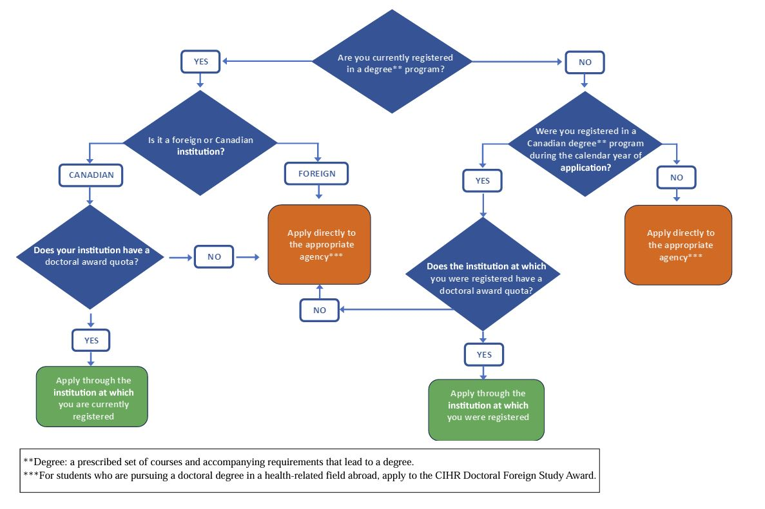
Where to Submit My Application
If you are unsure of your registration status, please contact Graduate Studies: gradawards@sfu.ca
Notes:
https://www.nserc-crsng.gc.ca/Students-Etudiants/PG-CS/cgrsd-besrd_eng.asp#a5
https://www.nserc-crsng.gc.ca/_doc/Students-Etudiants/CGSDFlowchart_e.PDF

Slide 14
Selection Criteria – CGRS Doctoral
Research ability and potential 50%
Quality of research proposal
  specific, focused and feasible research question(s) and/or
  objective(s)
  clear description and soundness of the proposed methodology
  significance and expected contributions to research
Demonstration of potential to carry out proposed research relative to the stage of study, lived experience, and knowledge systems
Demonstration of originality, initiative, autonomy, relevant community involvements, and outreach
Relevant experience and achievements obtained within and beyond academia 50%
scholarships, awards and distinctions
academic records (i.e. transcripts)
professional, academic and extracurricular activities as well as collaborations with supervisors, colleagues, peers, students, and members of the community, such as teaching, mentoring, supervising, etc.
Visit their website here for full description of the selection criteria.

Slide 15
Selection Criteria – CGRS Doctoral
Research Potential 50% | Relevant Experience + Achievements 50% (within and beyond academia)
quality of research proposal | relevant training
potential to carry out proposed research | scholarships, awards and distinctions
quality of contributions and extent to which they advance the field of research | academic record (transcripts, duration of studies, course load, relative standings)
demonstration of sound judgment and ability to think critically | professional, academic, and extracurricular activities, as well as collaborations within and outside of academia
demonstration of responsible and ethical research conduct
demonstration of originality, initiative, autonomy, relevant community involvement
ability to communicate theoretical, technical and/or scientific concepts clearly

Slide 16
Referees
CGRS – Master’s: 2 reference assessments
CGRS - Doctoral: 2 references (CIHR calls them sponsors and SSHRC calls them letters of appraisal)
One referee should be very familiar with your research and abilities (e.g., current or previous research supervisor) and the other should be sufficiently familiar with your research and abilities to provide meaningful commentary.
  Enter your strongest referee first in the system.
  They should provide concrete examples of your experiences that align with the evaluation criteria.
  If your past supervisor is unable to provide you with a report on the applicant, you may use the “Special Circumstance” section to provide an explanation, depending on the competition.
Applicants will not be able to submit their application without letters – inform your referees to complete their reference letters before the competition deadline.

Slide 17
Transcripts
Order official transcripts early – you will need to scan and upload them into 1 PDF.
Our office can help combine the transcripts into 1 PDF file.
SFU Official Transcripts – order them early so that there’s enough time for our office to print them. You can order and put the information below so that our office can print, scan, and send it to you.
SFU Graduate Studies
ATTN: Graduate Scholarships
1100 Maggie Benston Centre
Simon Fraser University
8888 University Drive
Burnaby, BC, V5A 1S6
Canada
Although the Tri-Agency has been flexible regarding official vs. non-official transcripts over the past few years due to COVID, all transcripts will still need to be verified by our office to make sure that they are acceptable by the Tri-Agency.
International transcript equivalencies
Transcripts must be presented in one of Canada's two official languages (English or French) or include a certified translation.

Slide 18
Avoid these common mistakes:
NOT giving your referees concrete examples for them to write about.
NOT following presentation standards, page limits or attachment sizes (system gives error messages and prevents uploads).
NOT defining acronyms or using too much jargon. Don’t be too technical - the proposal needs to be written in a lay person language.
NOT writing about methods/methodology.
NOT reading instructions, not seeking answers to eligibility concerns (gradawards@sfu.ca)
NOT taking advantage of SFU Resources here to help:
      Graduate Studies Document Library has examples of applications
      SFU Library has Writing Services, including Read Ahead and Writing Consultations.

Slide 19
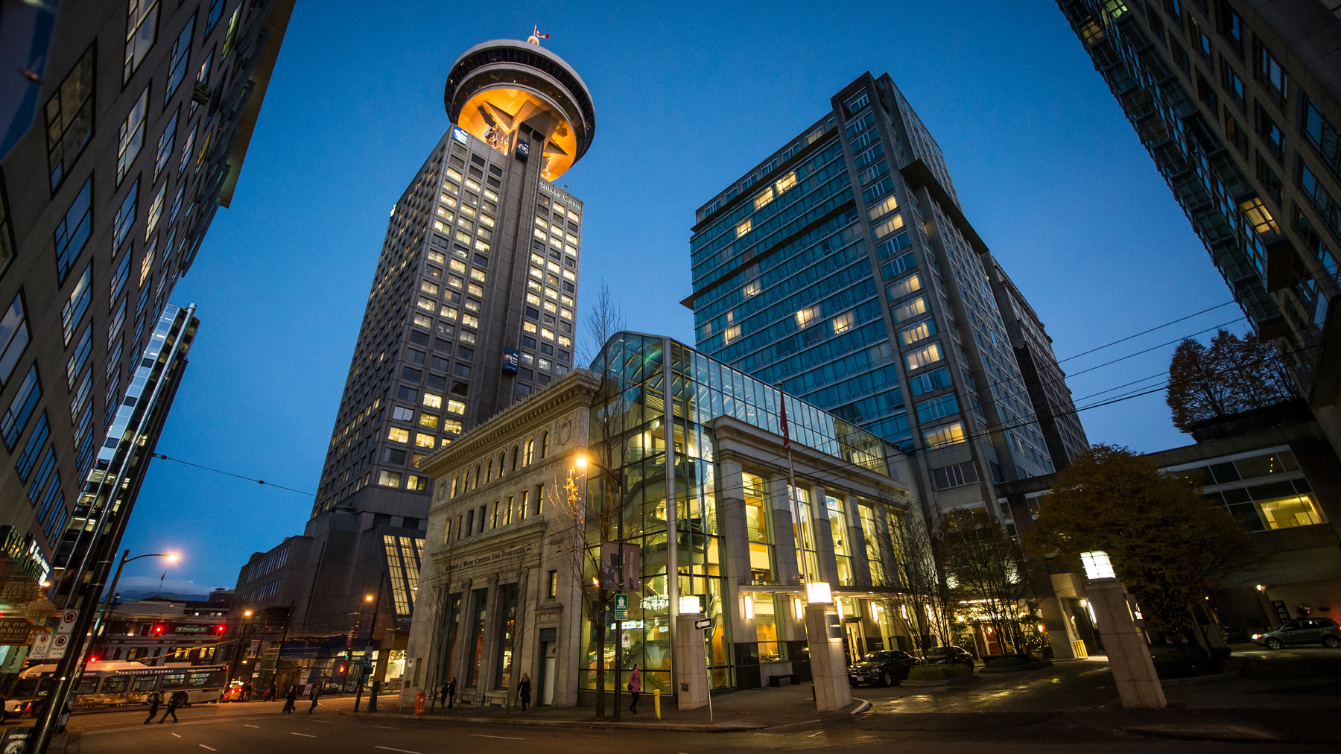
Questions for Faculty of Graduate Studies?
Faculty of Graduate Studies
Contact the award & finance teams at:
gradawards@sfu.ca

Slide 20
Thank you
Notes:
This file was last updated 20250729.

